Slide 1

Houston, We Have an Allergy Problem
Predicting Pollen Counts in Texas
May, 2022

Slide 2

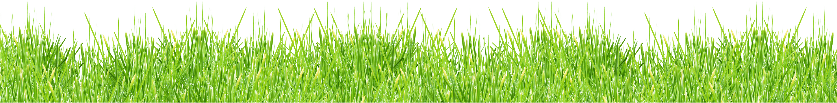
Flat Iron Data Science Graduate www.github.com/nikennedy nrokennedy@gmail.com
Nicholas Ross O’Keefe Kennedy
This Photo by Unknown Author is licensed under CC BY-NC

Slide 3
Agenda:
1. Introduction & Business Understanding
2. Business Problem
5. Modeling: Classification & Time-Series
3. Data Understanding
4. Initial Analysis
6. Results
7. Species-Specific Diagnostic Tool Proposal
10. References & Appendix
8. Further Considerations
9. Conclusion

Slide 4
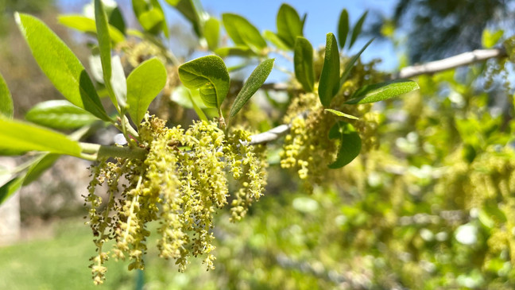
Introduction: Allergies & Public Health After Covid-19
Heightened Public Awareness of Allergies
2. Seasonal Strain on Healthcare Providers

Slide 5

Allergies: A Business Problem
Preparing Medical Providers & the General Public
for Allergy Season Through Public Health Initiatives

Slide 6

The Data: Pollen
All Pollen Data From Houston Health Dept.
Monthly Tallies of Species-Specific Pollen Counts per m³
Business Days from January 2013 to April 2022
This Photo by Unknown Author is licensed under CC BY-NC

Slide 7

The Data: Climate
Daily Climate Data from
2 Testing Centers in Houston, TX, 1 from Shreveport, LA
Average Daily Temp (F),
Average Wind Speed (mph),
Precipitation (inches)
This Photo by Unknown Author is licensed under CC BY-NC
This Photo by Unknown Author is licensed under CC BY

Slide 8
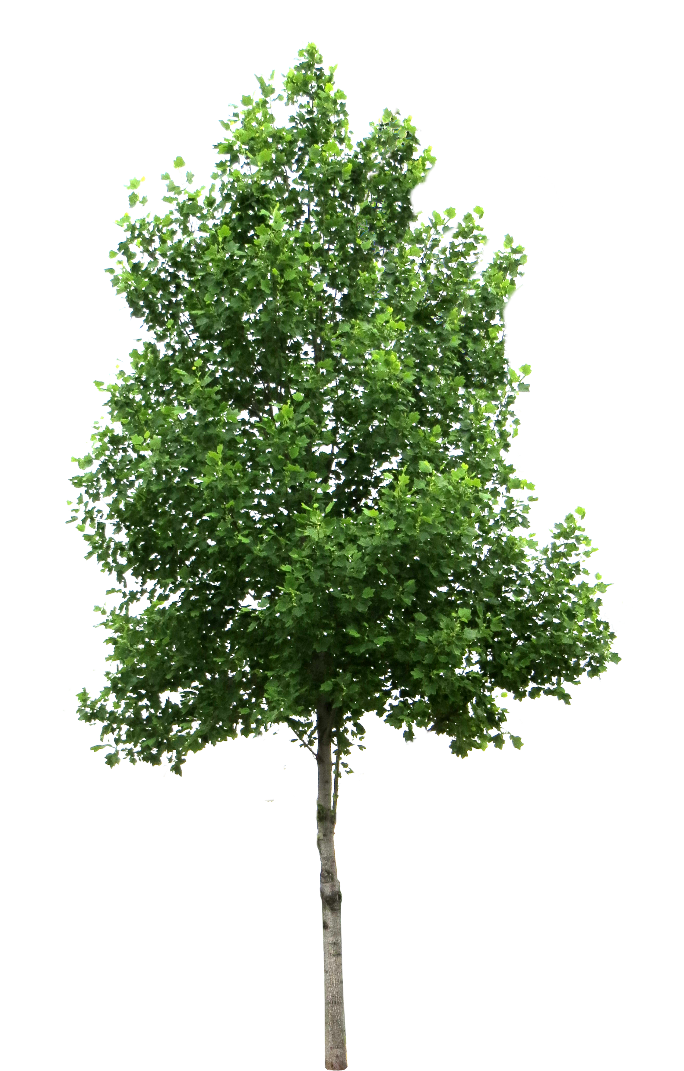
Pollen Counts & Allergies
TREE POLLEN:
90-1499 /m³: Heavy
1500+ /m³: Extremely Heavy
GRASS POLLEN:
20-199/m³: Heavy
200+ /m³: Extremely Heavy
WEED POLLEN:
50-499 /m³ : Heavy
500+ /m³: Extremely Heavy
This Photo by Unknown Author is licensed under CC BY-NC
This Photo by Unknown Author is licensed under CC BY-NC

Slide 9
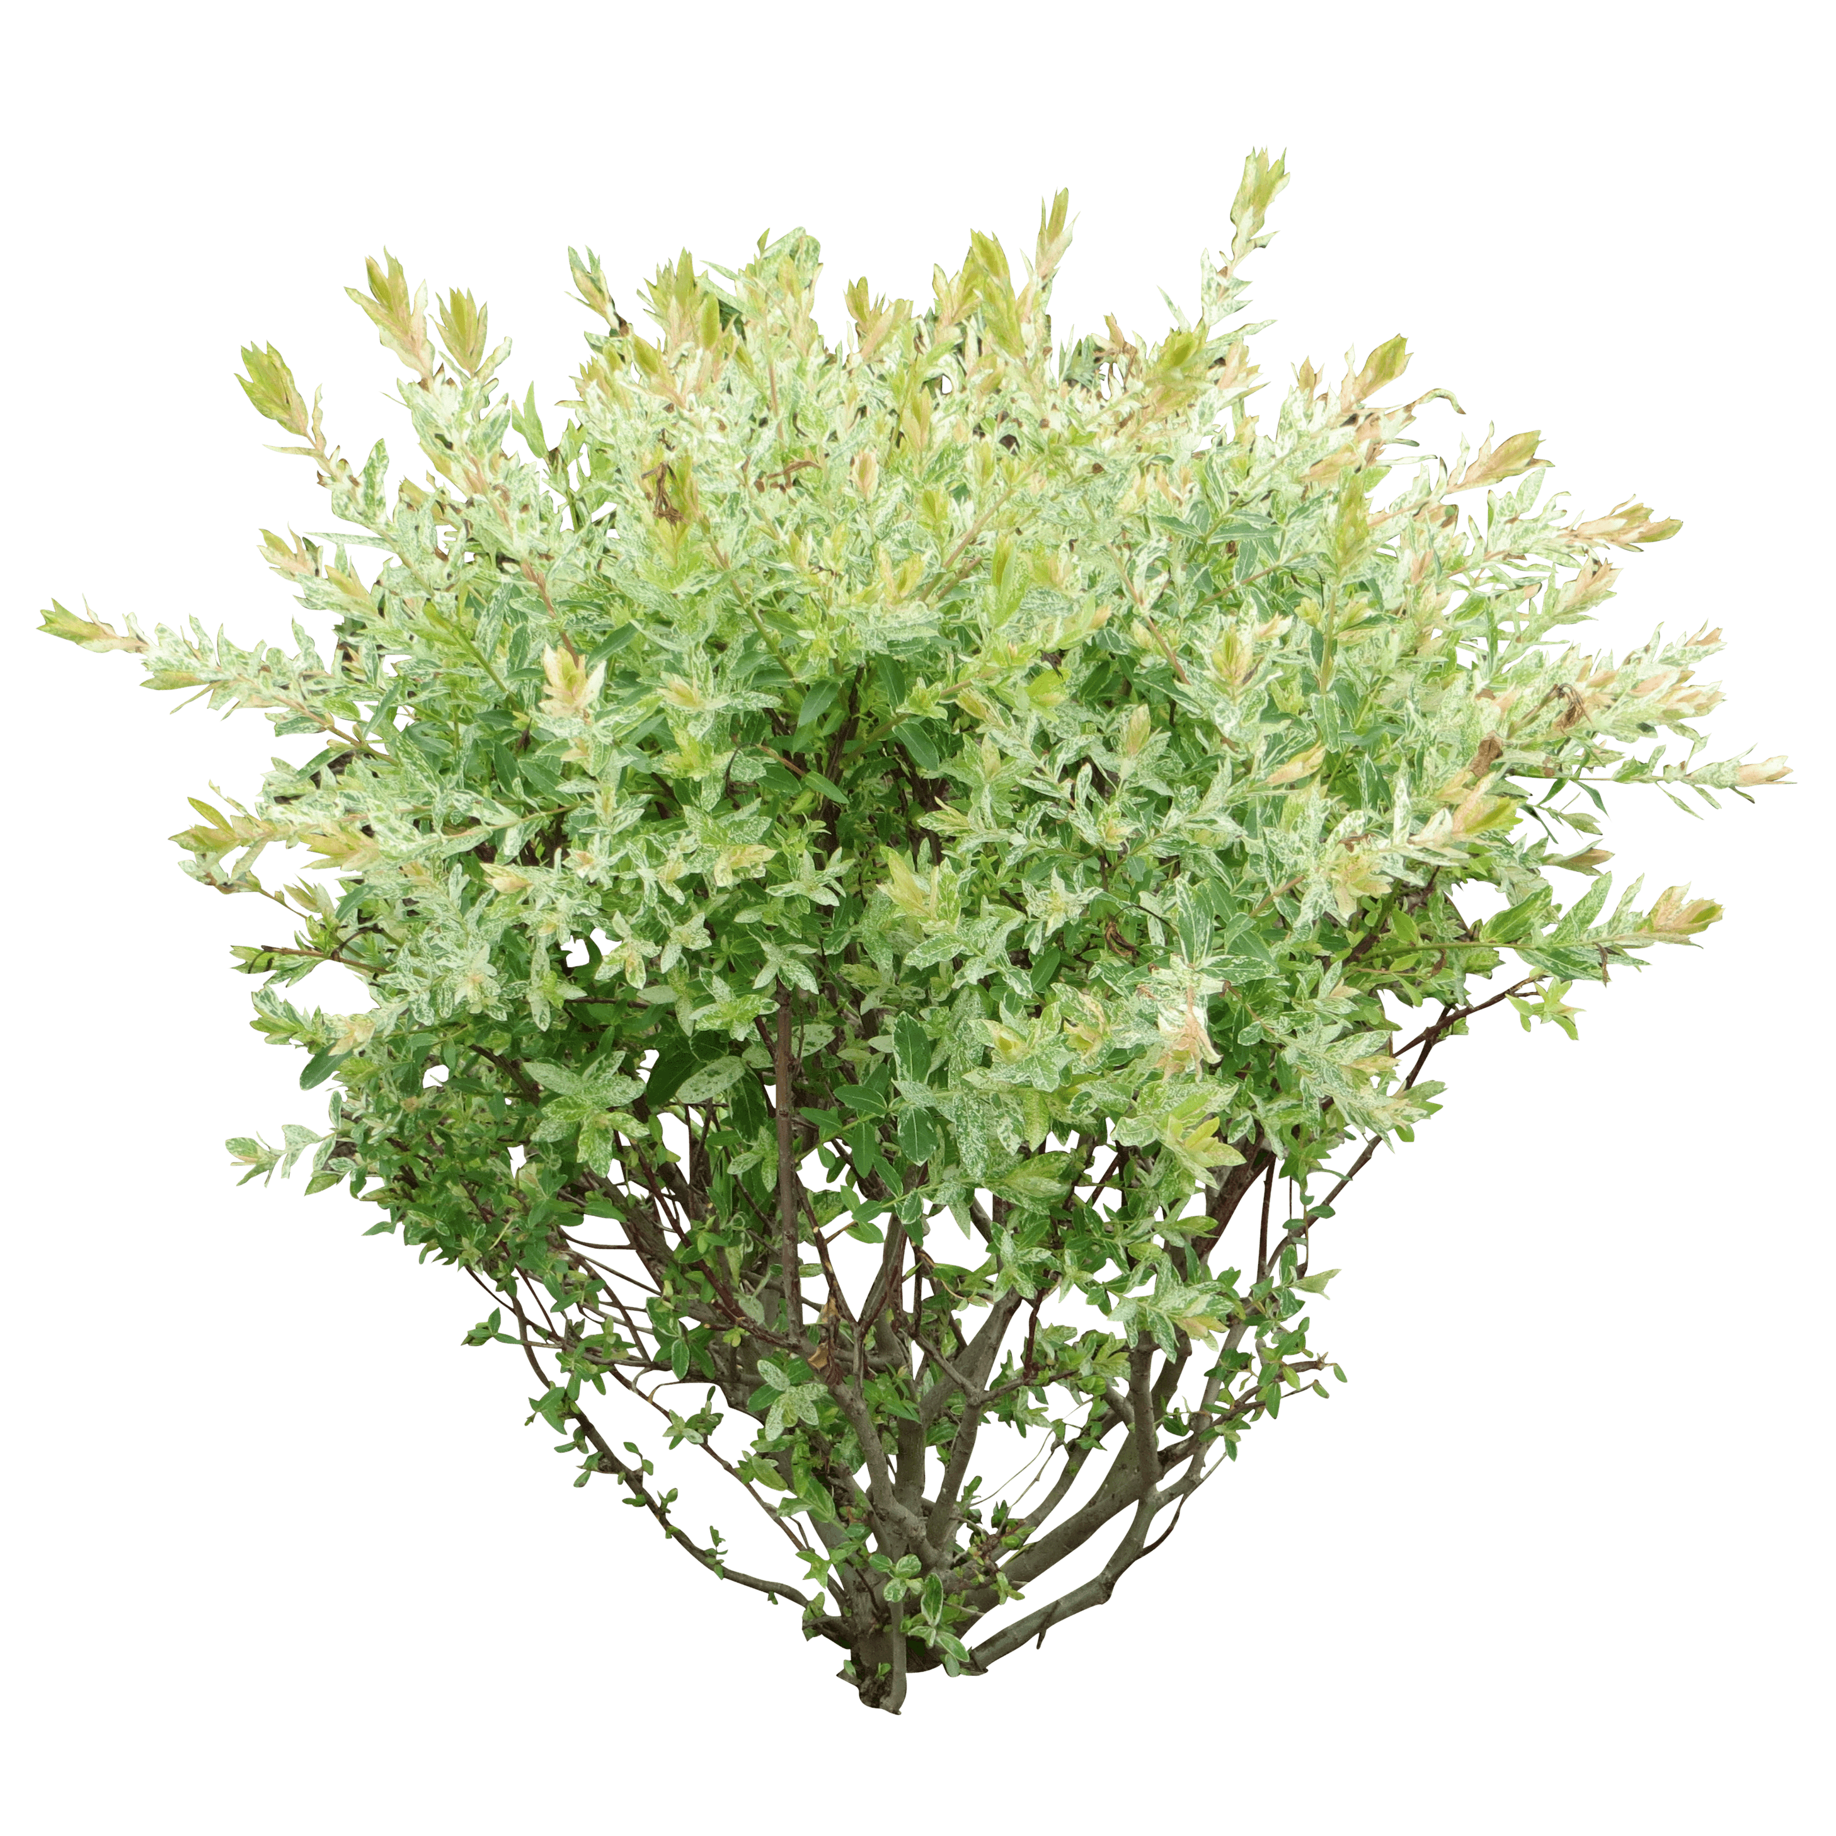
Weighted Pollen Counts
Weighted using Different Severities of Tree, Grass and Weed
“high” pollen set at 500+ particles per m³ per HHD
~50% of days ‘high’ pollen for Houston, TX
This Photo by Unknown Author is licensed under CC BY-NC
This Photo by Unknown Author is licensed under CC BY-NC

Slide 10
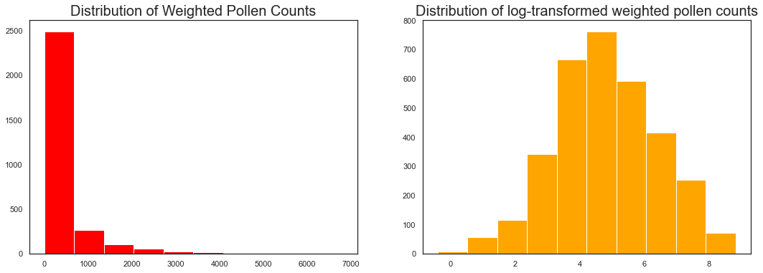
Exploratory Findings
Many Days had pollen counts of zero especially in summertime
Max Pollen Count of over 9,000 per m³ occurred in March, 2019
Pollen’s Logarithmic Distribution

Slide 11
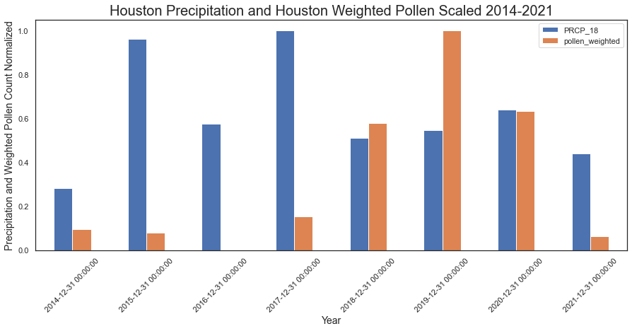
Exploratory Findings
* Also True for Shreveport,
& other variables (see Appendix)
No Clear Correlation Between Local Precipitation* and Pollen Counts for Current or Prior Year

Slide 12
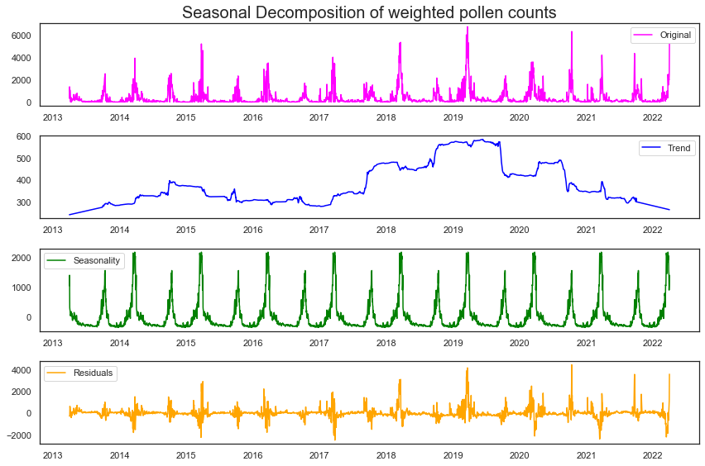
Classification Modeling: The Seasonality Problem

Slide 13
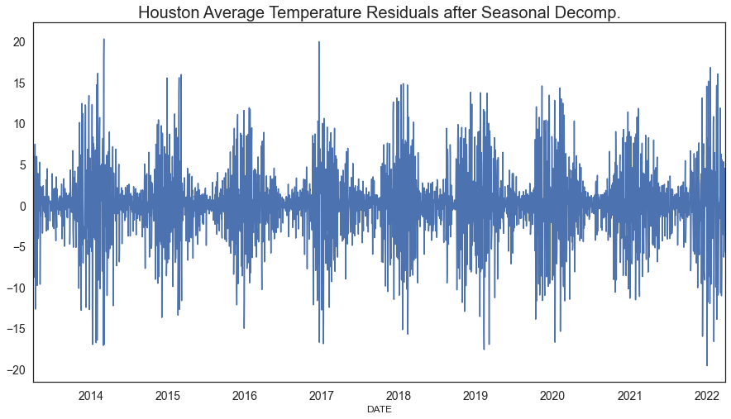
Classification Modeling
Decision Tree Model: Local Temp most important feature
Random Forest Classifier Achieved 60% Accuracy
Seasonality after decomposition?

Slide 14
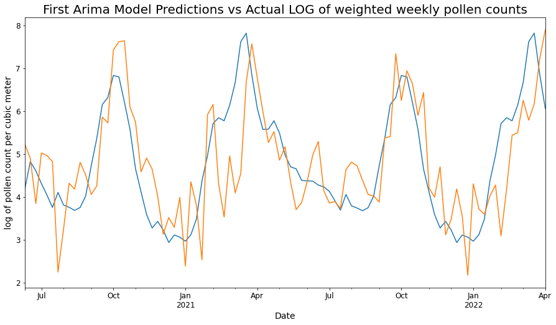
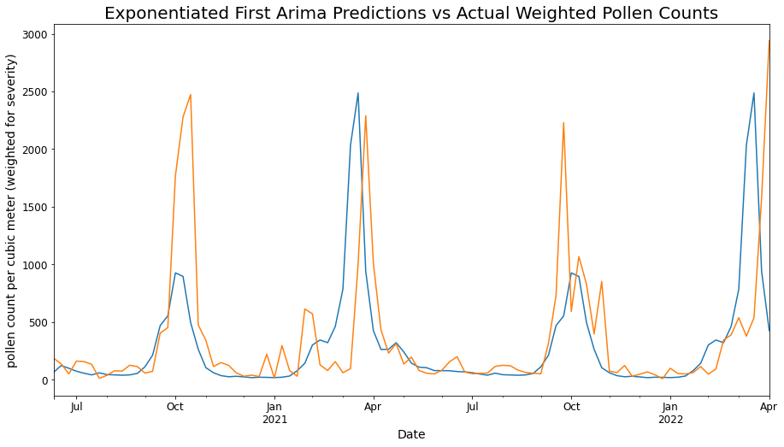
Time-Series Modeling

Slide 15
Results
Classification:
Best Model was Random Forest 60% Accuracy, 59% Precision
Time Series:
Best Predictor was Prior Year’s Pollen Counts
Off by ~ 425 particles per m³ on average

Slide 16
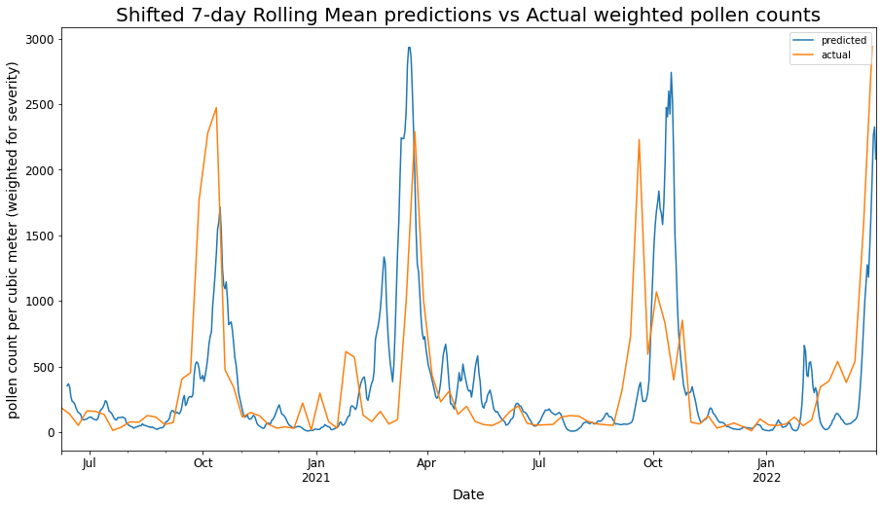
Results: Best Predictions from Last Year

Slide 17

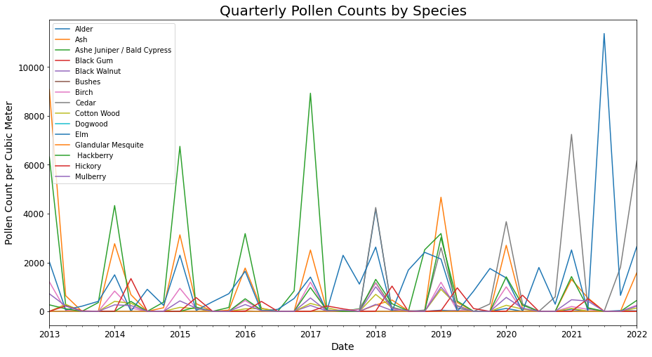
Proposal for Next Steps: Species-Specific Diagnostic Tool

Slide 18

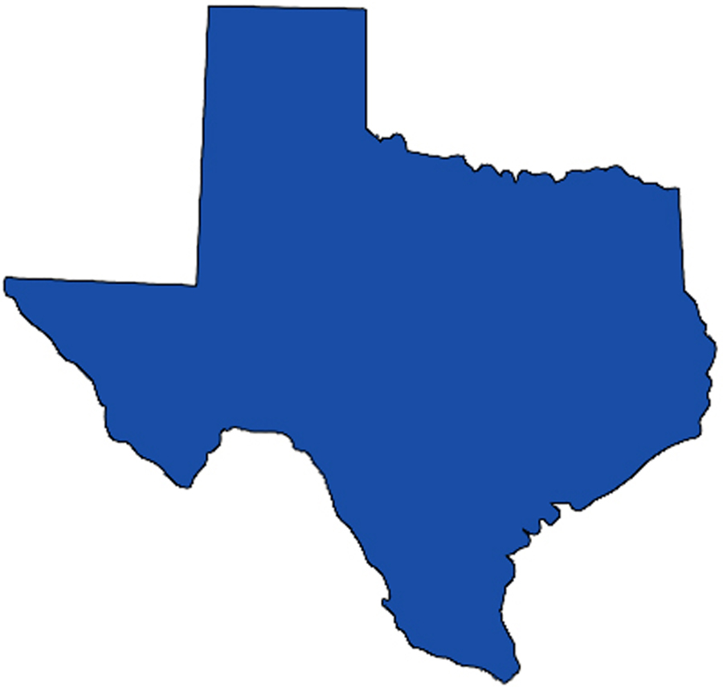
Further Considerations:
Mold Spores
2. More Local and Statewide Data
This Photo by Unknown Author is licensed under CC BY-NC-ND

Slide 19
Conclusion
Seasonality is King
The local seasonality of pollen production is the best
predictor of pollen counts.

Slide 20
Thanks! Questions and Comments
Flat Iron Data Science Graduate www.github.com/nikennedy nrokennedy@gmail.com

Slide 21
References
Mold Spores
More Local and Statewide Data

Slide 22
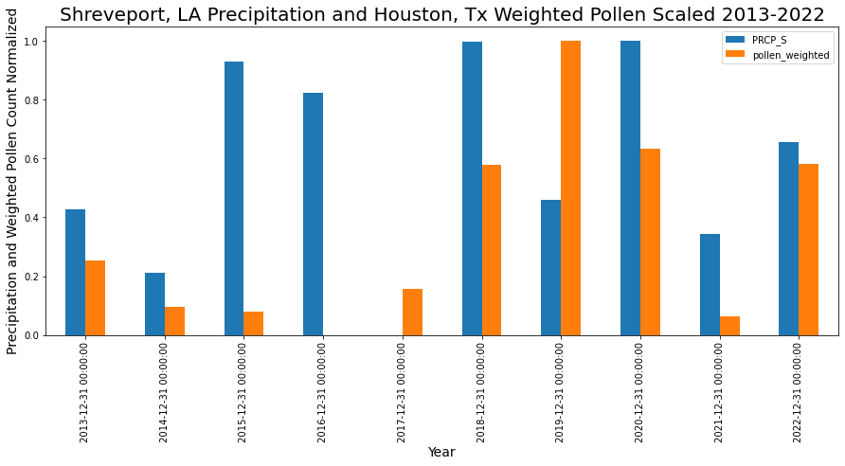
Appendix

